Slide 1
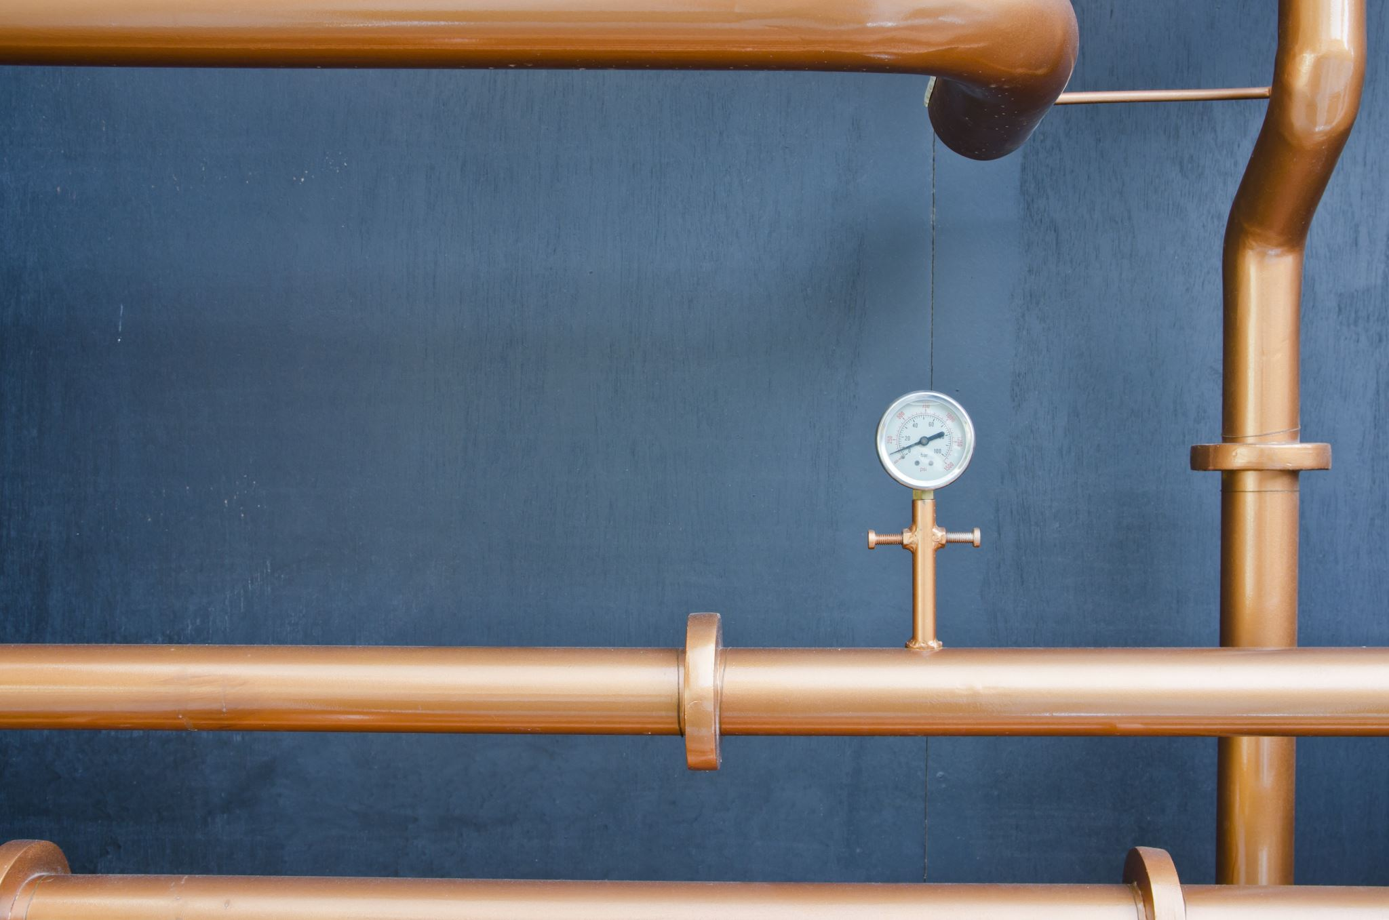
Couchbase stress testing application
BeerFast

Slide 2

BeerFast
Why BeerFast ?
Code repository
Tinariven/BeerFast
Author
Michał Joachimski & Copilot “pair programming”

Slide 3
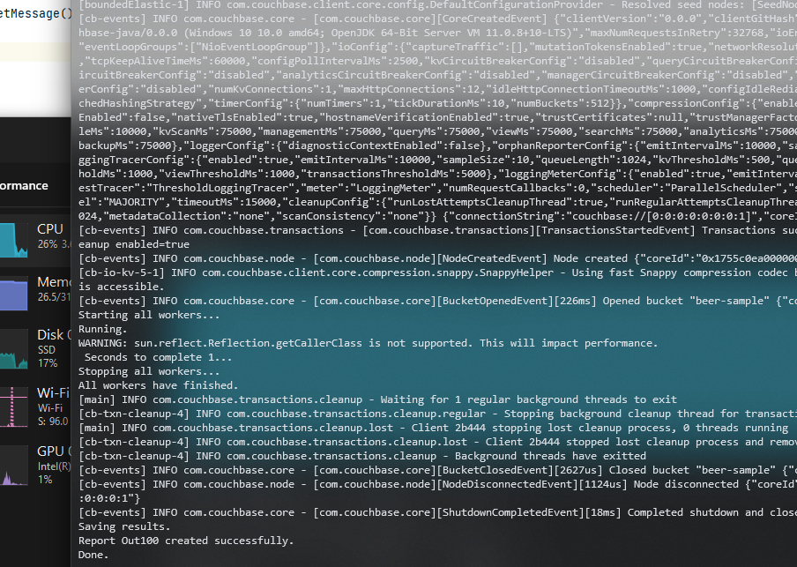
Test conditions
Coachbase installed as Docker container inside WSL Ubuntu (Windows Subsystem Linux)
Run on
13th Gen Intel(R) Core(TM) i7-1370P 1.90 GHz
32GB RAM
Java 11 OpenJDK build 11.0.8

Slide 4
Test scenario
Run with 1,10,50,100,1000 number of threads
Loaded up 100 json files
Test over 180 seconds
8 measures collected
Output stored as csv files
Measures
Thread start and end timestamp [ms]
Number of loops executed
Document loading duration (loadDuration) [ms]
Document retrieving duration (getResultDuration) [ms]
Number of document read & loaded (filesRead)
Number of document retrieved (documentCalls)
Document volume (dataVolume) [B]

Slide 5
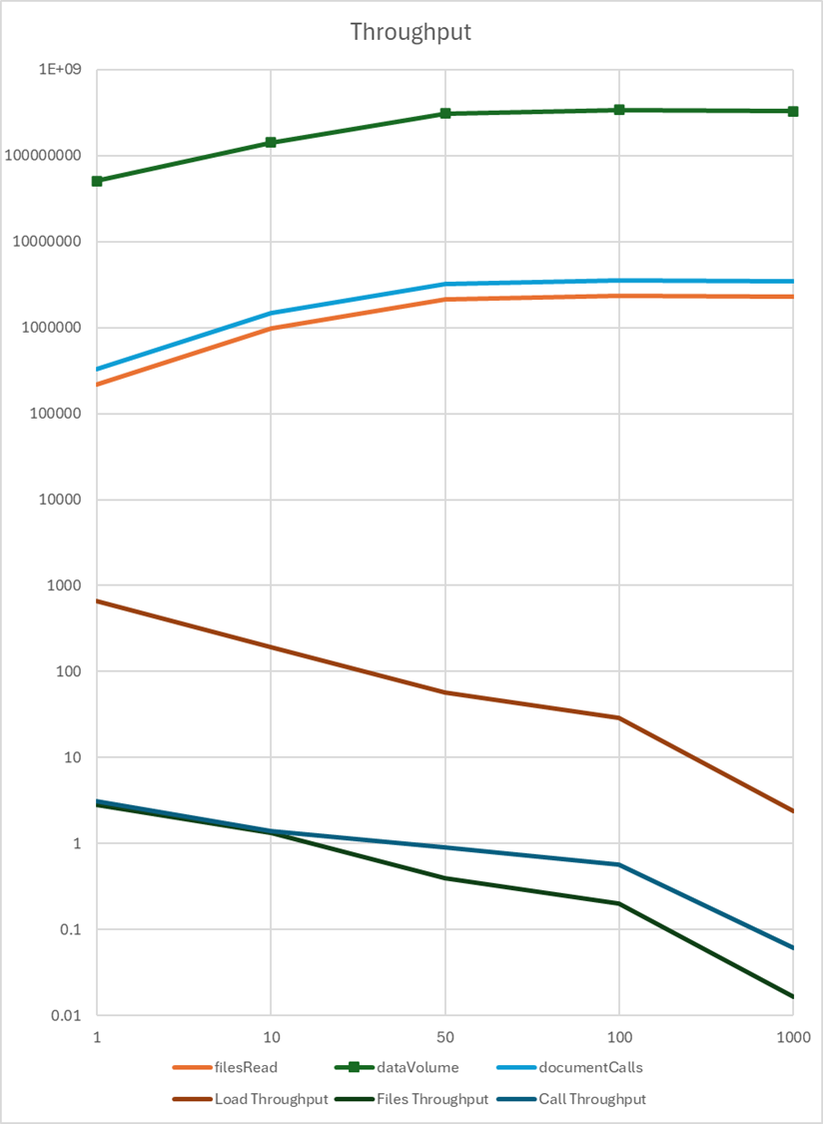
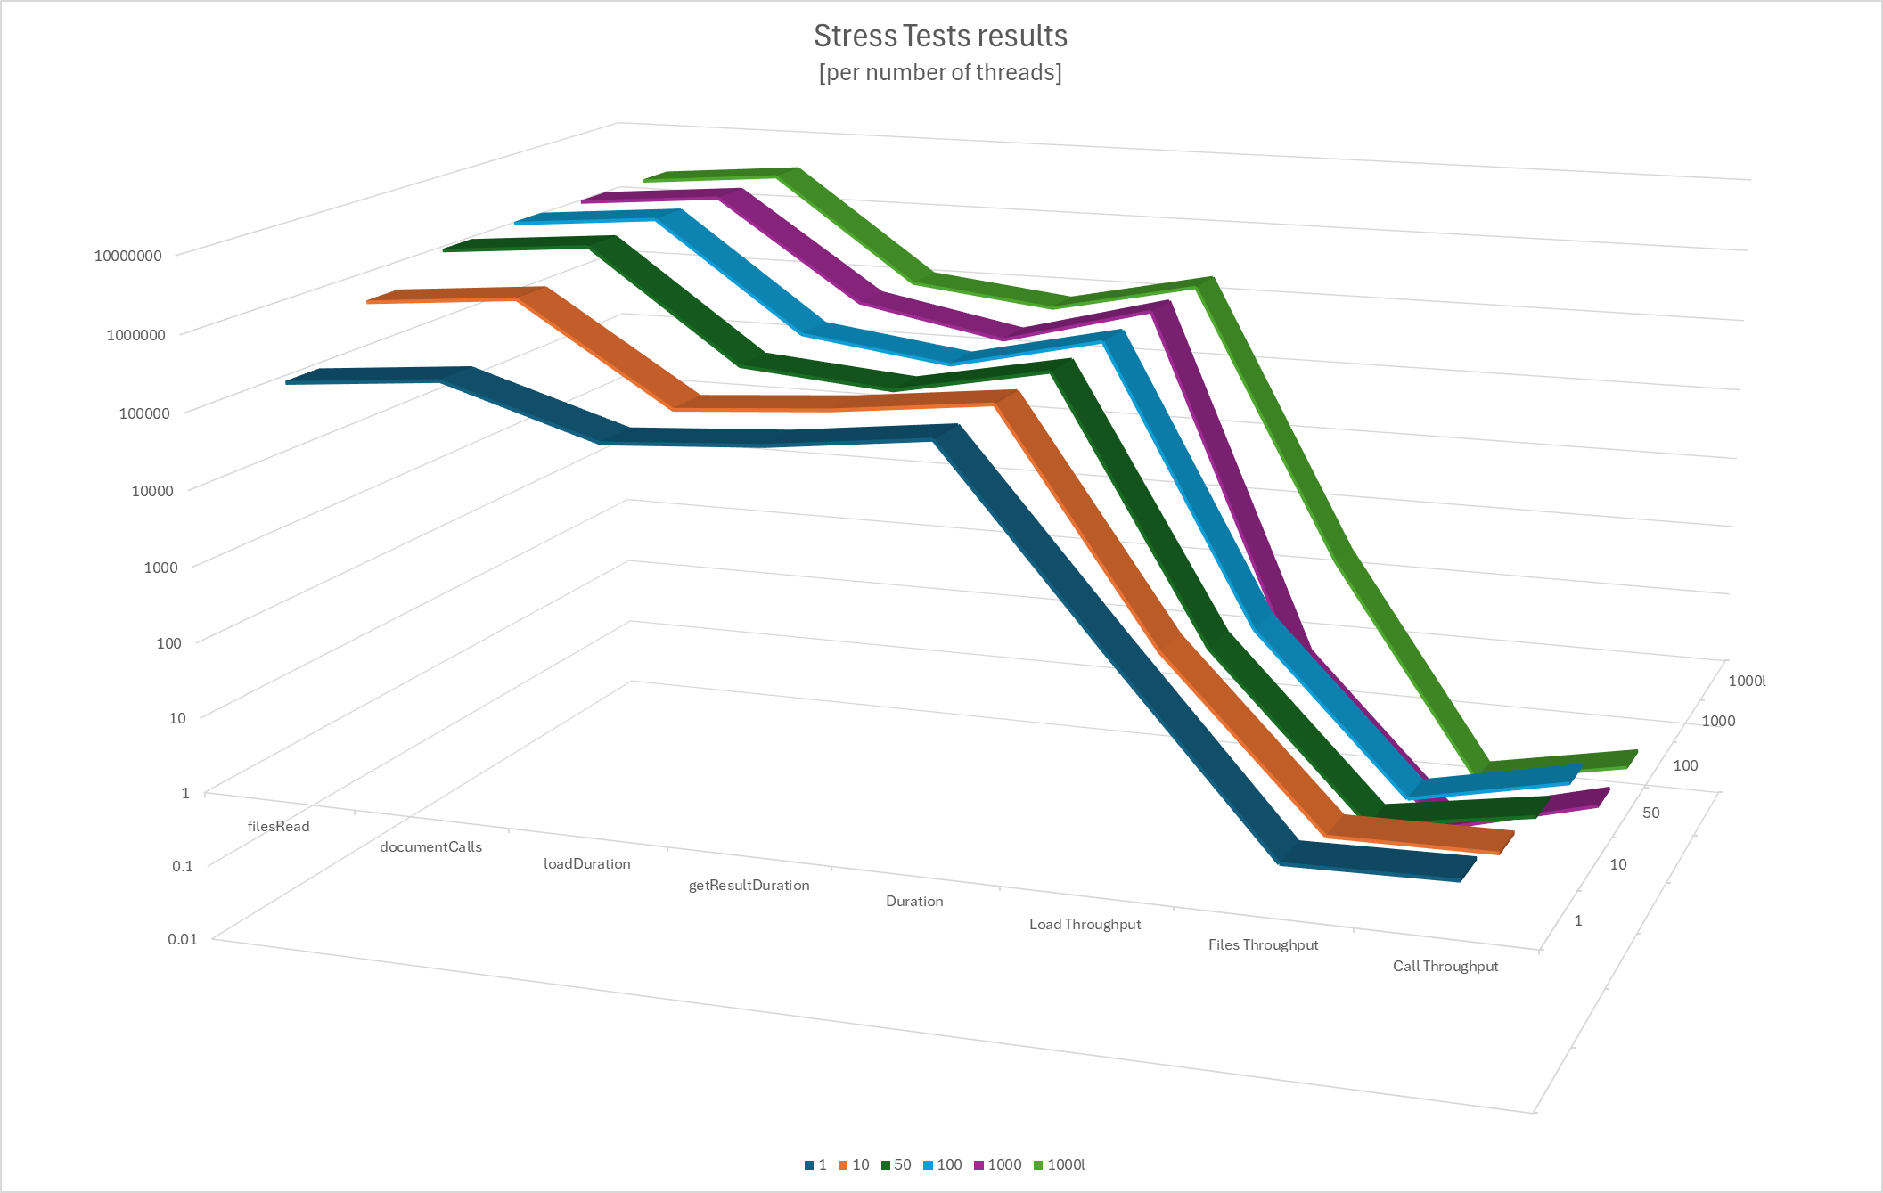
Test results

Slide 6
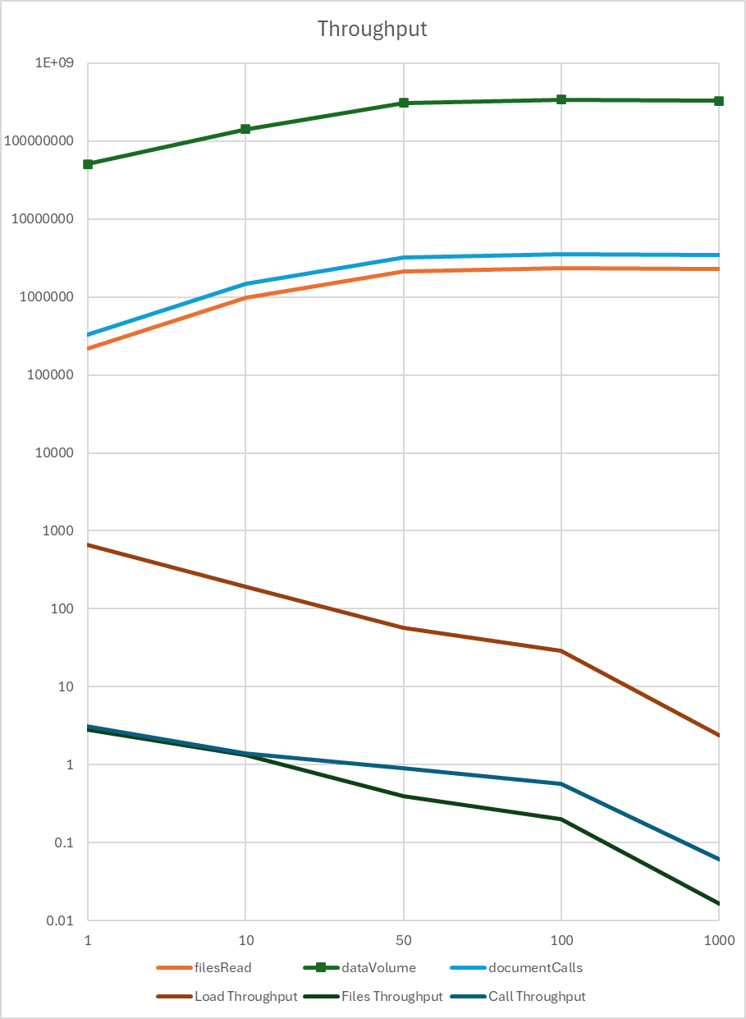
Conclusions
Increasing number of threads
From 1 to 10 increases number of documents processed by 3.5x
Jump from 10 to 50 just doubles quantity
100 gives only 10% increase over 50
1000 threads does not bring value
With large number of threads > 100
CPU, disk (IO) and Couchbase API limitation became a bottle neck
Increasing the size of documents 10x does not affect performance

Slide 7

Final thoughts
It was fun to do this exercise
Good is enough
Each code can be improved, but do not need to
Programming is like riding the bicycle
You can change bike but do not forget how to ride
AI automates simple tasks
I’ve recall/learned a lot ☺
I like beer

